Slide 1
Employees as Change Agents
Getting social business right depends on more than understanding what your customers or stakeholders are talking about and how that relates to your firm.
Social business depends as well on connecting your employees into the social processes.
For example, the learning the social data collected may be routed to and applied in marketing, to operations areas like customer support or to other departments within the organization where it can be acted on.

Slide 2
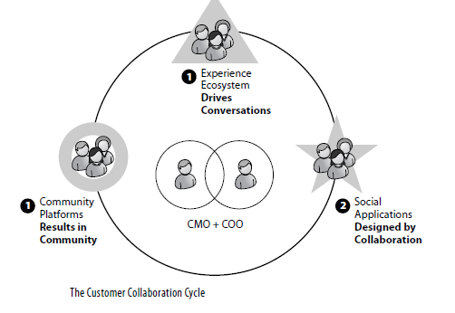
Cont…

Slide 3
Empower an Organization
Consider the following scenario: Imagine that your employer is a major hospital chain. Clearly, this is a complex business, and one that customers readily talk about. Health care in a sense is one of the “this was made for social” business verticals: It cries out for the application of social technology.
Taking off on social media marketing, imagine that you are in the marketing group perhaps you are a CMO, a VP of Marketing, Director of Communications, or PR, or advertising for a community hospital.

